Slide 1
Design Inspirations
Zheng Yu Lin
09/10/19

Slide 2

A Japanese video game development company founded in November 1986.

Slide 3
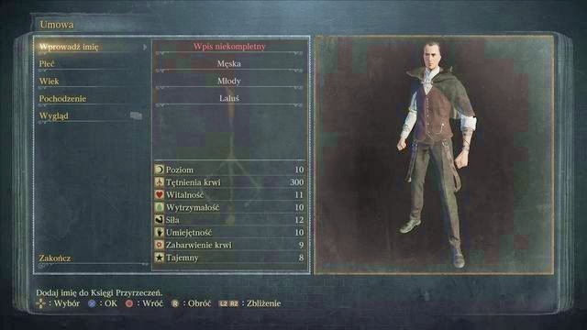
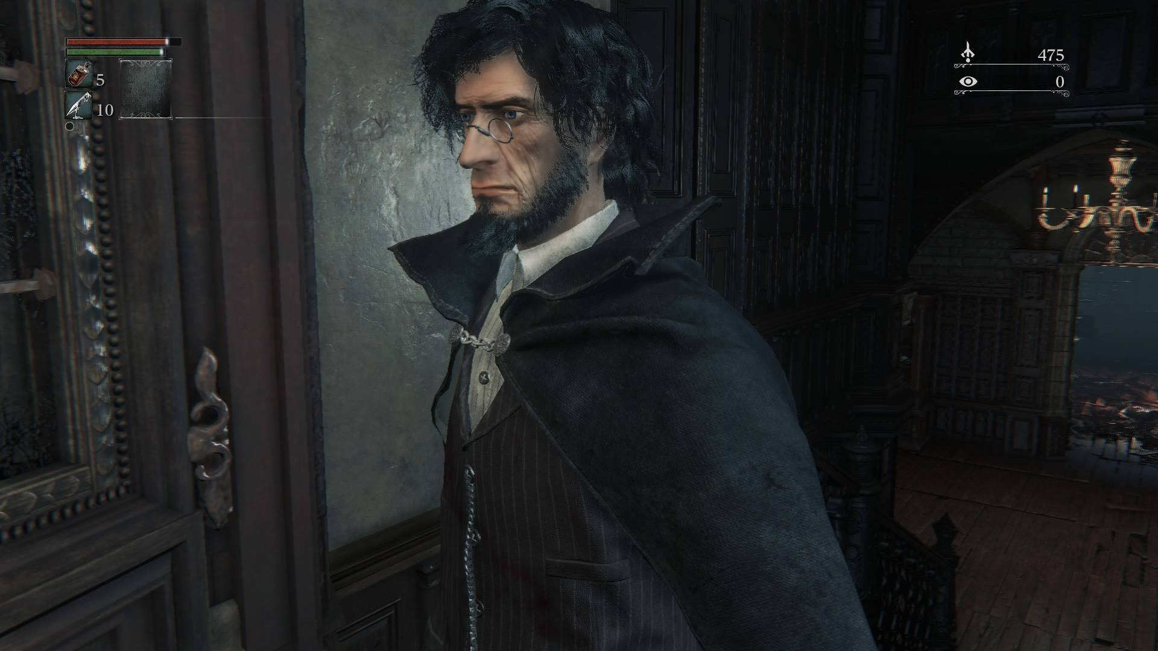
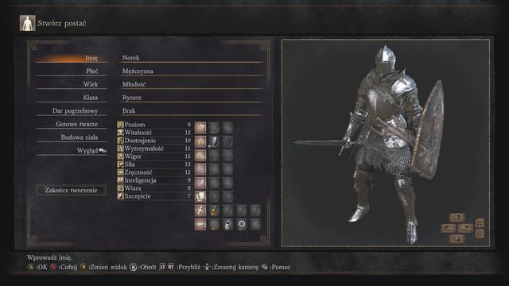
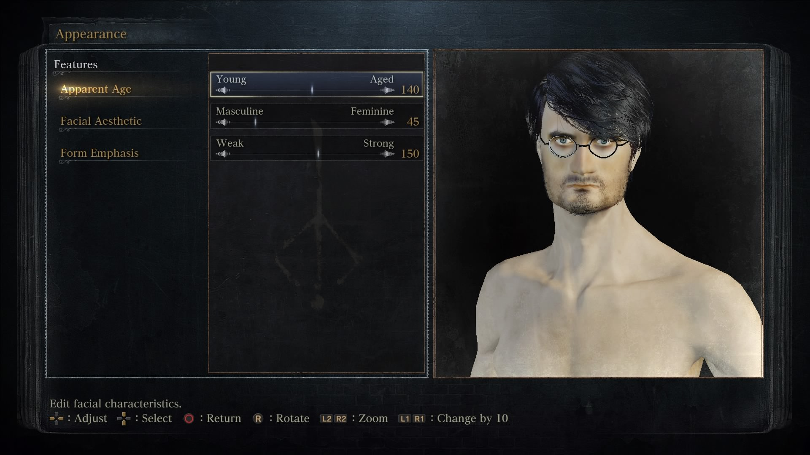
Character Design
Bloodborne
Dark Souls III

Slide 4
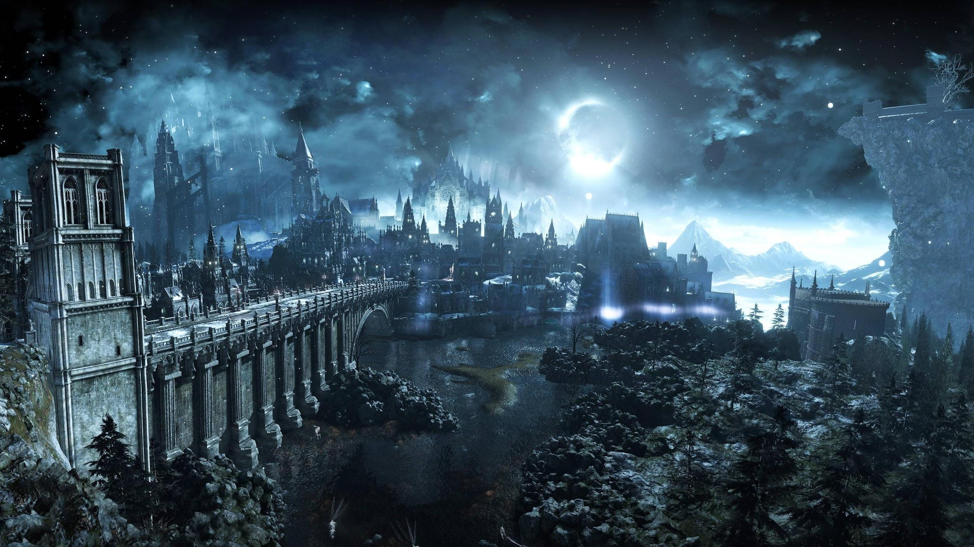
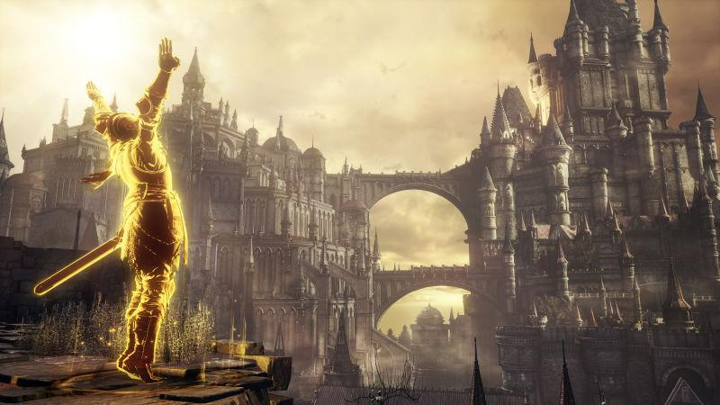
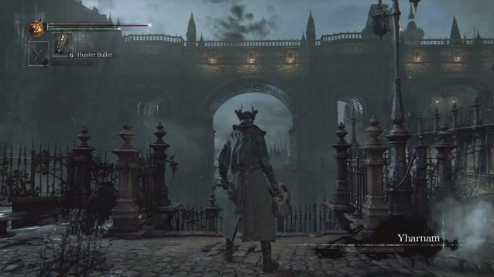
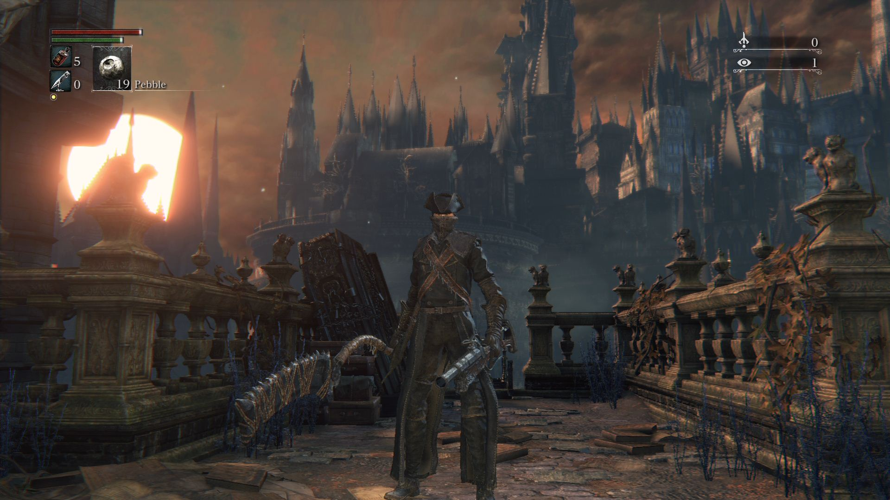
Background Design

Slide 5
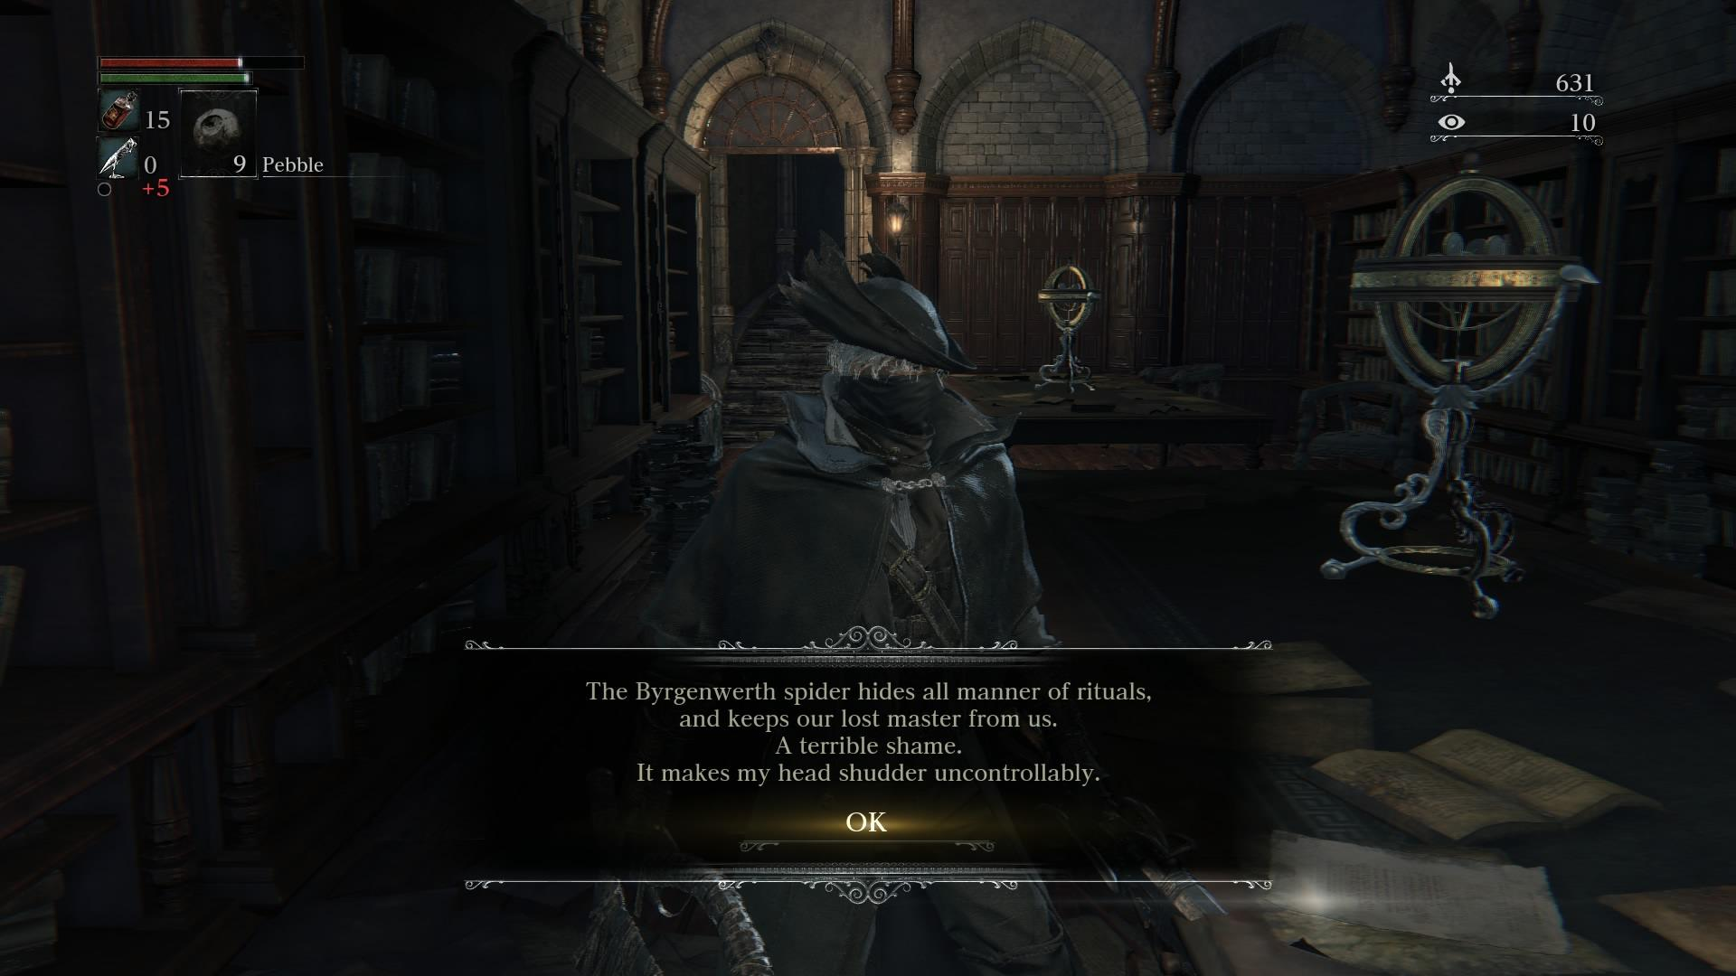
Plot
In Bloodborne and the Dark Souls series, the plots are usually very vague, most of time players needs to guess and connect the little hints that you would found throughout the game.

